Slide 1



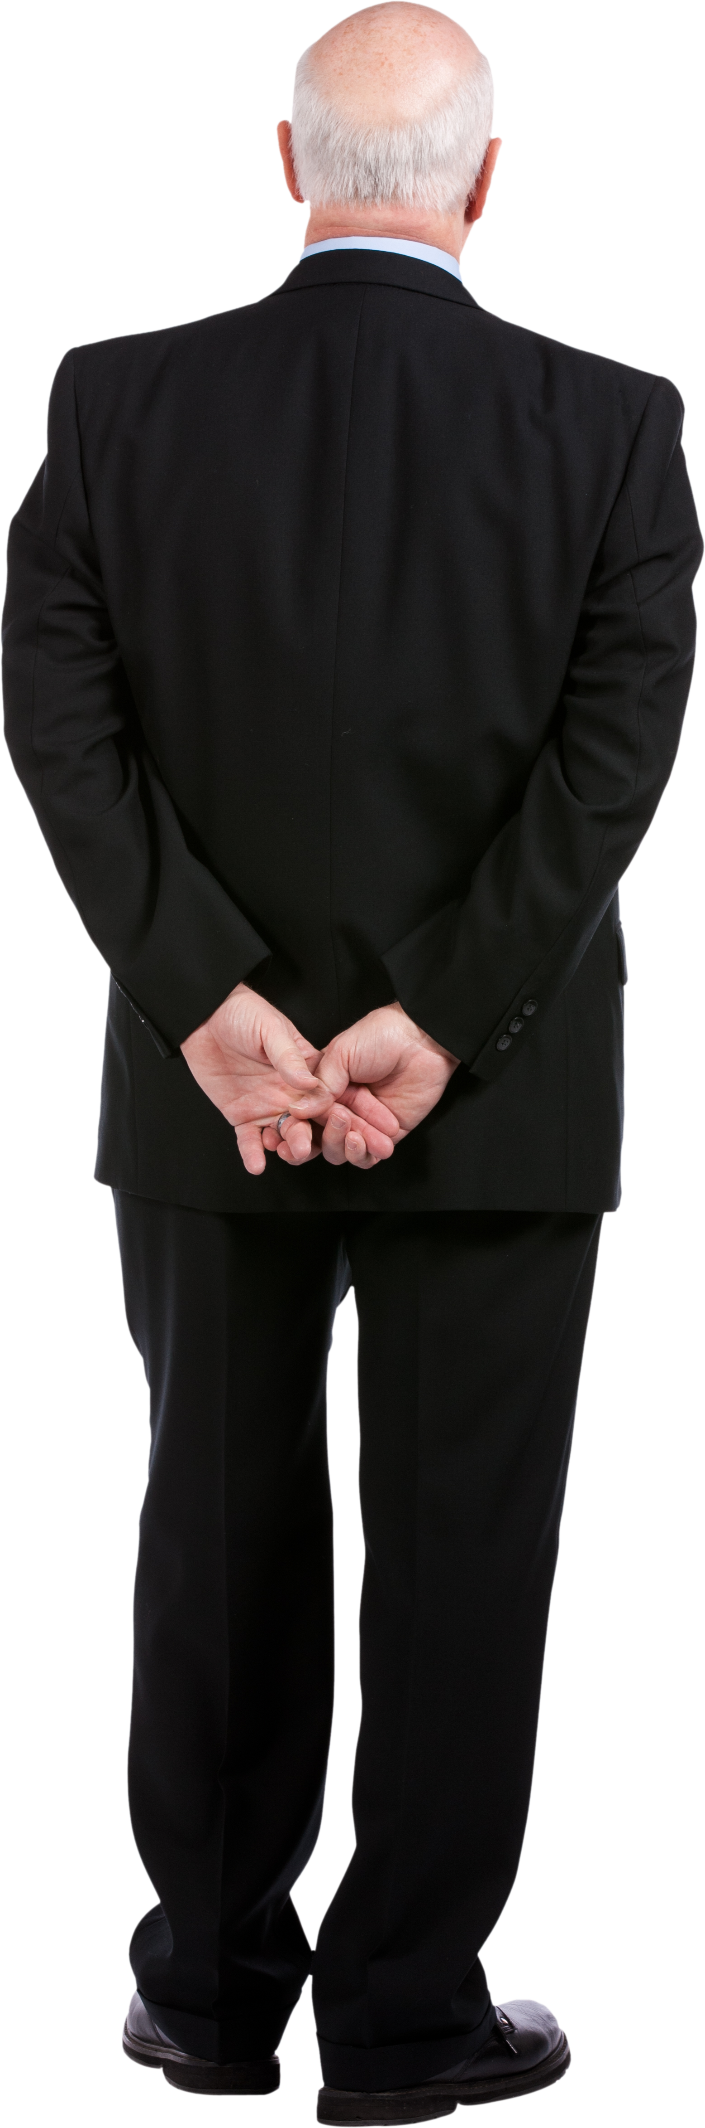


Team syntax terror
Omar flores – quinton callicott – Daniel g.
CSCI 154 THANOs

Slide 2

Motivation?

Slide 3

Problem Statement?

Slide 4
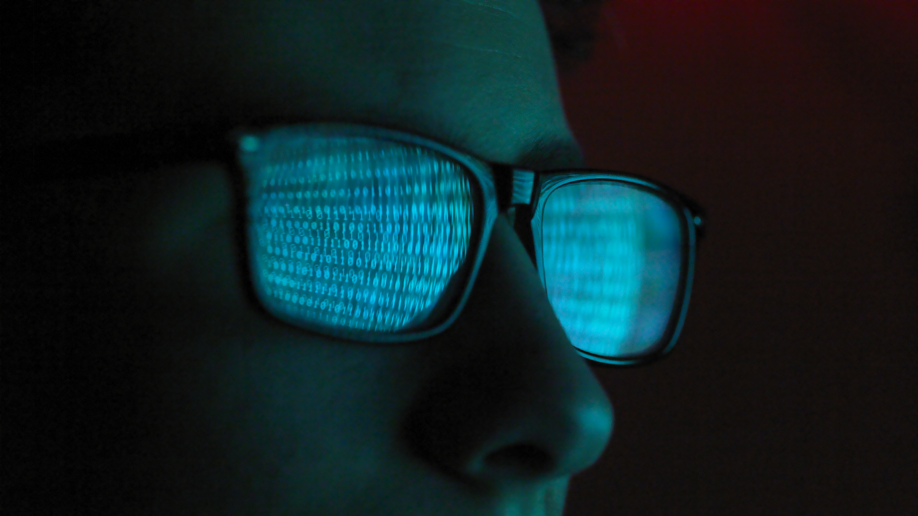
Our Approach & Results
- Our Approach & results

Slide 5
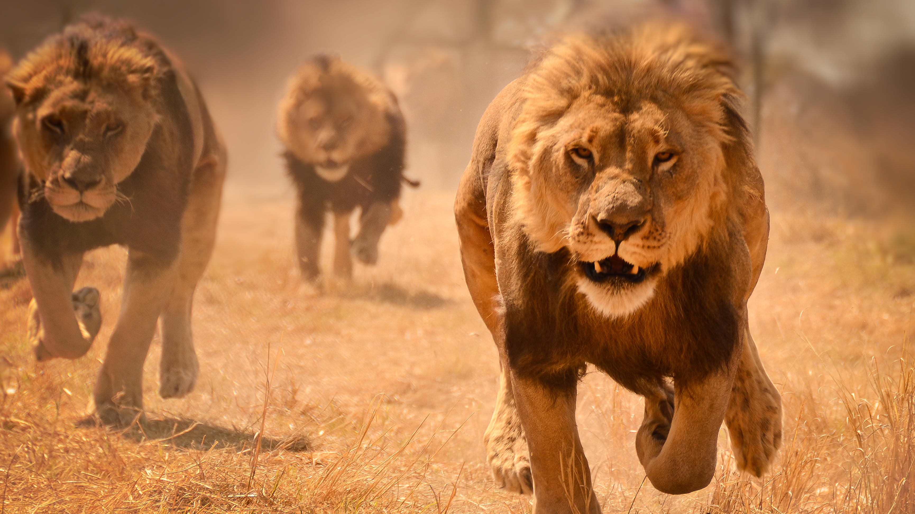
CONCLUSION
The best is yet to come
Our next step will be our best step
Daniel
Quinton
Omar

